Slide 1
Intro to Data Science
Final Project
By Joseph harris

Slide 2

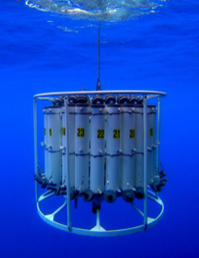
Dataset Background
The dataset is pulled from data that has been collected by CalCOFI, the California Cooperative Oceanic Fisheries Investigations ecosystem. ​
The seawater samples this specific subset is pulled from was began in 1949 and is still being collected today.
While the collection tool has changed at various times, since 1993 they have been using the CTD-Rosette (pictured on this slide.)

Slide 3
Dataset Background
Subset of the "Bottle Database" from CalCOFI
1000 rows and 6 columns before any data cleaning has been done
The 6 columns and their data definition:
First column is unnamed and is likely the ID for that row
Depthm: How deep the collection bottles were in the ocean (in meters)
T_degC: The water temperature at the time of collection (this is in Celsius)
Salnty: The salinity of the water (the measurement of dissolved salts in the water)
O2ml_L: Milliliters oxygen per liter of seawater
STheta: Potential Density (density of a fluid parcel like water if it were moved with no loss or gain in heat.) This data point allows for consistency across collections without having to consider the pressure in the ocean.

Slide 4
Question:
Does an increase in temperature lead to an increase in dissolved salt in the ocean water?
Does the data show that if the water temperature goes up, does the salinity also go up? Are they potentially related in any way?
What are some theories on what this means or what this could impact?

Slide 5
Data Cleaning Process
Data cleaning process (ETL)
Python was used via Google Colabs
This was the most familiar tool/language discussed during class for me and felt more confident in getting information from the data this way
I used the lessons from this class to complete the data cleaning but I did complete a column rename and referred to the official Pandas Python documentation (source provided at end of slides)

Slide 6
Data Cleaning Process
First, I imported Pandas in to Python
I followed that by adding the bottles.csv data to my JCCC Google Drive and then mounted it within my Python notebook.
I was able to gather some initial info; such as rows x columns (1000 x 6), that there were NULL values in each column
There was no clarifying info on what the unnamed column was
It could be assumed that was the random ID number giving to that bottle but was unable to be confirmed via the data source

Slide 7
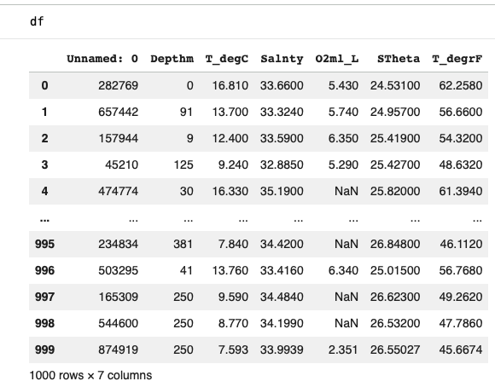
Data Cleaning Process
I decided to add a new column that converts the T_degC column to T_degrC and would provide the temperatures in Fahrenheit.
Df['T_degrC'] = (df['T_degC'] * 9/5) + 32
With the new column, I decided to make a slight change to it's header to make it more clear this is the temp converted to Fahrenheit.
Df.rename(columns={'T_degrC': 'T_degrF'}, inplace=True)
The new dataframe now looked like this:

Slide 8
Data Cleaning Process
Now that I had the temperature addressed, the NULL values needed to be addressed.
Reviewing data set in Excel, it was identified the only column that didn't have any nulls was the first, unnamed column.
Some of the rows had multiple NULL values.
So any row with 1 or more NULL value was dropped from the data frame.
Df.dropna(thresh=7)
This requires if the row did not have 7 values (as there is the new T_degrF column making it 7), then that row would be dropped from the data frame.
This brought it down from 1000 rows to 752 rows.
This was done rather than adding the mean/median/etc to the NULL values due to the inconsistency across columns.

Slide 9
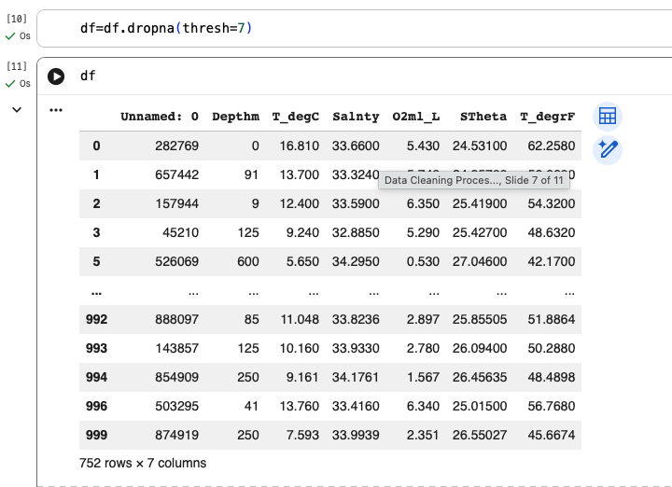
Data Cleaning Process
The final step I took was to create a new dataframe, so not to cause issues when creating the scatter plot.
Df=df.dropna(thresh=7)​

Slide 10
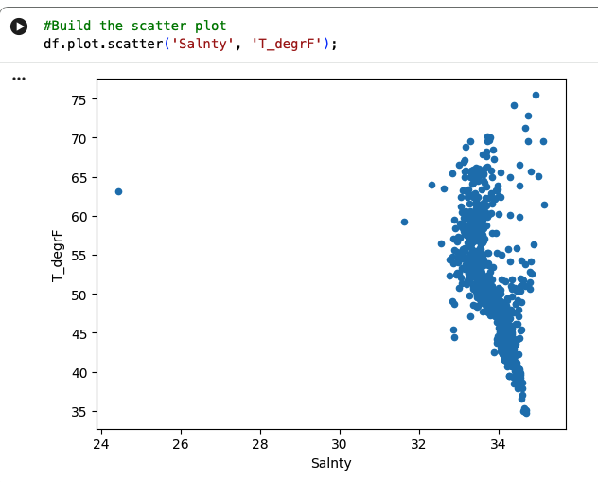
Scatter Plot
Once the data had been cleaned, it was time to use Python to create a Scatter Plot.
First scatter plot: df.plot.scatter('Salnty', 'T_degrF');
No linear relationship could be derived from this; there is high salinity at both high and low temps as well as low salinity at both high and low temps.
It does show that there are some outliers; I will remove those as well

Slide 11
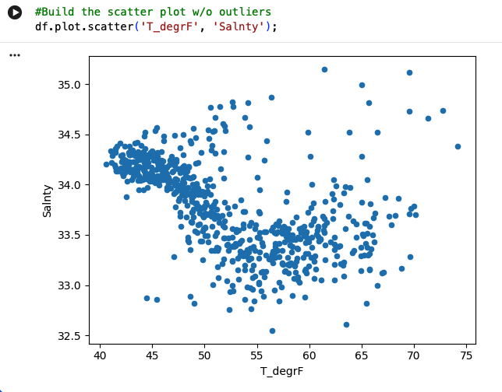

Scatter Plot
Did the following to remove the few outliers that became obvious
Q1 = df.quantile(0.25)
Q3 = df.quantile(0.75)
IQR = Q3 - Q1
df = df[~((df < (Q1 - 1.5 * IQR)) |(df > (Q3 + 1.5 * IQR))).any(axis=1)]​
I built the scatter plot with the new df which was 705 rows of data
The new scatter plot is to the right and it does appear there is a non-linear regression (crudely illustrated with the free hand line/arrow)

Slide 12
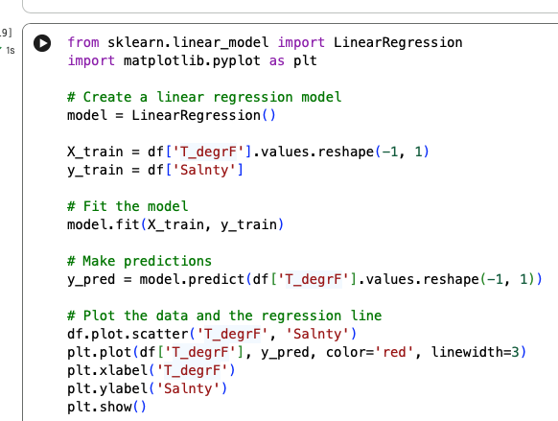
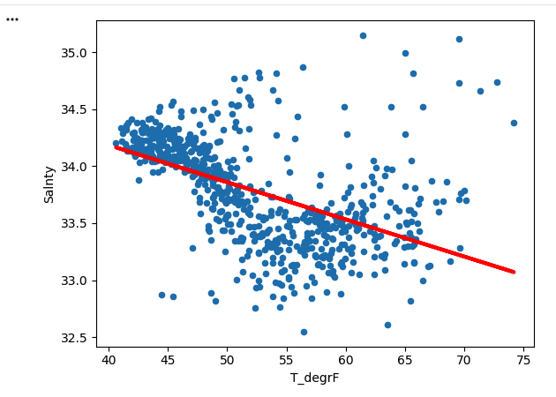
Regression
I used the linear training equation we learned in class to confirm there is nonlinear regression​
With the regression line, it turns in to an example "underfitting"

Slide 13
Findings
After data cleaning and building my scatter plot model, I utilized regression (which would fall under supervised machine learning) to try and confirm if there is potentially a direct relationship between increased temp leading to an increase in dissolved water.
The relationship does not seem to be linear, it would fall under non-linear. That is still categorized as supervised machine learning. ​

Slide 14
Takeaways
Due to there not being a clear linear relationship, it can not be concluded that as temperatures rise, salinity goes up.
Thoughts on where I would go next:
I would want to add a 3rd variable, mostly O2ml_L, to see if the amount of oxygen in the sample could be impacting this.
If that still did not establish a clear linear connection, I would consider expanding to the full dataset available from CalCOFI. I think having a full range of data could help me determine that either their truly isn't a relationship between the temperature and the salinity or that there is just another variable that needs to be considered.

Slide 15
Sources
https://calcofi.org/
https://calcofi.org/data/oceanographic-data/bottle-database/
https://www.epa.gov/national-aquatic-resource-surveys/indicators-salinity
https://www.nature.com/scitable/knowledge/library/key-physical-variables-in-the-ocean-temperature-102805293/
https://pandas.pydata.org/pandas-docs/stable/reference/api/pandas.DataFrame.dropna.html
https://pandas.pydata.org/docs/reference/api/pandas.DataFrame.rename.html

